Slide 1
Lane Line Finding Project
By: Cody Nicholson & Merga Tafa

Slide 2
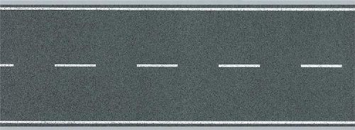
Outline
Abstract
Problem Statement & Motivation
Related Work
Methodology
Evaluation/Interpretation/Conclusion
References
Questions

Slide 3
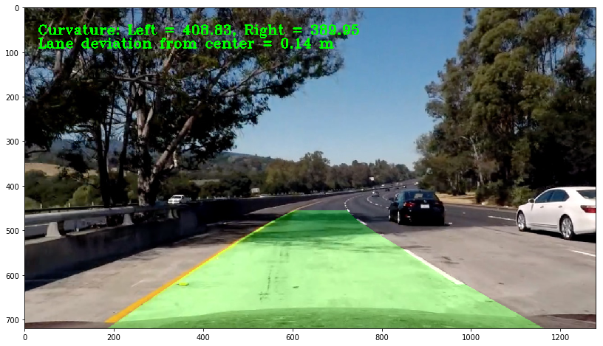
Abstract
We created a program to detect lane lines in front of a moving vehicle. We did this by correcting distortion caused by the camera lens, using color transformations and gradients to create a thresholded binary image, applying a perspective transformation to turn our image into a top-down view, detecting lane pixels and fitting them to find the lane boundary, determining the curvature of the lane and vehicle position with respect to center, warping the detected lane boundaries back onto the original image, and outputting a visual display of the lane boundaries with the numerical estimation of lane curvature and vehicle position included in the image.

Slide 4
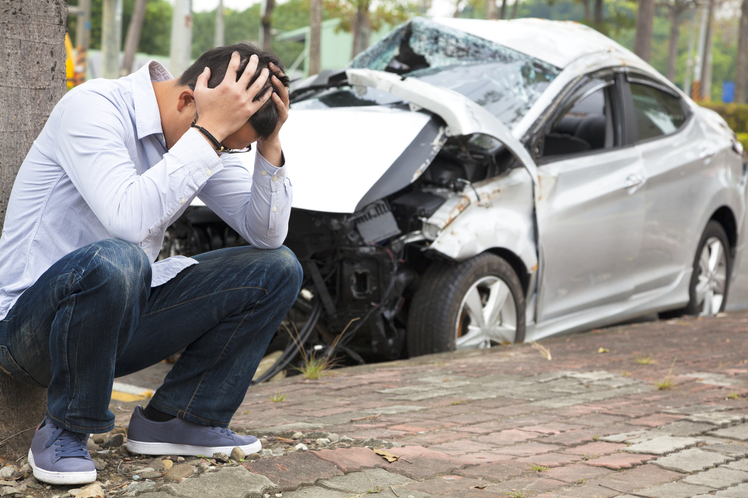
Problem Statement & Motivation
Over 30,000 people are killed in auto-related accidents each year in the United States alone. Save for a few outliers, the vast majority of these accidents can be attributed to human error.
What if we could create programs to detect and avoid these accidents with a lower error rate than humans? To this end, we created a program to detect lane lines in front of a moving vehicle. We hope that our research will benefit future endeavors to prevent auto-related accidents.

Slide 5
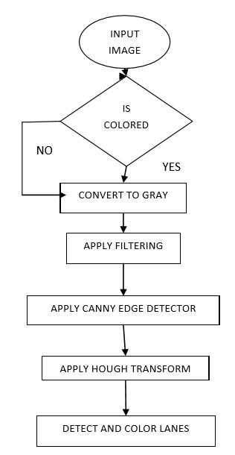
Paper 1: Lane Detecting techniques: A review
The main purpose of this paper is to detect lane markings and localizing any road markings. To achieve this goal, the edge detecting method is used to convert and segment those markings from RGB into binary images so that those markings of the edge can be seen as their intensity changes.
In a similar way, we made color transformation for lanes marking by creating a thresholded binary image to differentiate their color channel.

Slide 6
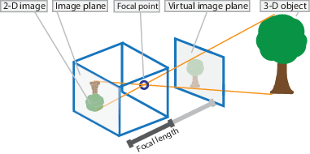
Paper 2: Camera Calibration with Distortion Models and Accuracy of Evaluation
According to this research paper, camera calibration is the essential task to measure the dimensions of the images as image coordinates (pixels) determine the exact position of camera and the points of interest of any scenes of image. The aim is to eliminate distortion of image points from their positions . One of the techniques used to find image points distortion is the projection of coordinates from 3-D of image plane projection and then iterative algorithms applied to detect the distortions.
Similarly, we used a chessboard to project coordinates of points from image in the form of (x, y, z) coordinates to adjust the distorted coordinates and applied some functions from algorithms to compute the calibration of the camera.

Slide 7
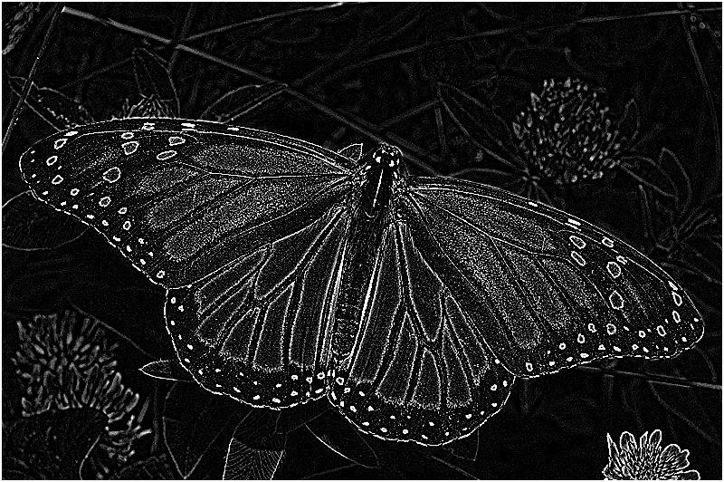
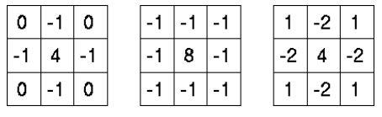
Paper 3: Structure-Preserving Color Transformations using Laplacian Commutativity
This paper gave us lots of examples of how Laplacian filters can be used to detect edges in images using derivatives. For this kind of filter, the edges will be detected if there is rapid change in in the color values at any point in the image.
After learning that the Laplacian filter has trouble dealing with noise, we decided that the Sobel Gx filter would be a better fit for the edge detection in our project.

Slide 8
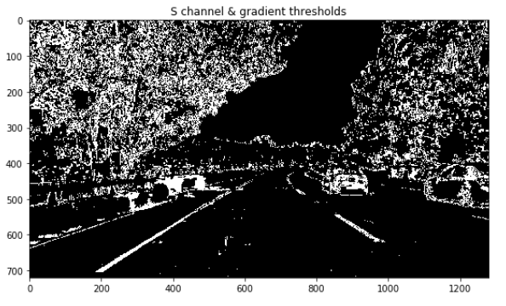
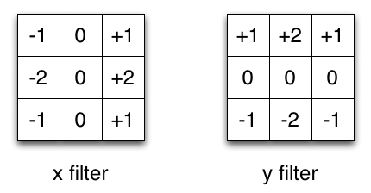
Paper 4: Study Sobel Edge Detection Effect on the Image Edges Using MATLAB
In this paper, the main goal is to inform the reader of how to implement edge detection techniques used on digital images. Edge detection methods can be applied in different ways to digital images. One method is the Sobel method of edge detection. The sobel method combines the horizontal and vertical masks as well as matrices to detect the maximum and minimum pixels to detect edges.
Since the lane lines are vertical relative to the driver, we used a Sobel_x filter to find the edge based on the brightest pixels in a vertical line.

Slide 9
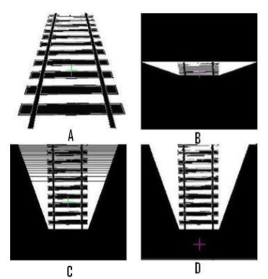
Paper 5: Transformation Techniques
This paper was all about changing the perspective of an image from a forward-facing one to a top-down perspective. In an image taken from a forward-facing perspective, it is hard to make out the objects near the top of the image since they are farther away. By stretching out the image in the farther away parts, we can get a better picture of what is going on in the image.
In our project we used this to identify lane lines that were farther away in the image. It was much easier for our program to process when the top image was transformed into a top-down perspective.

Slide 10
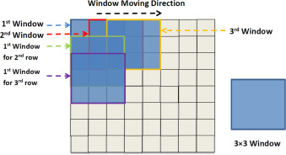
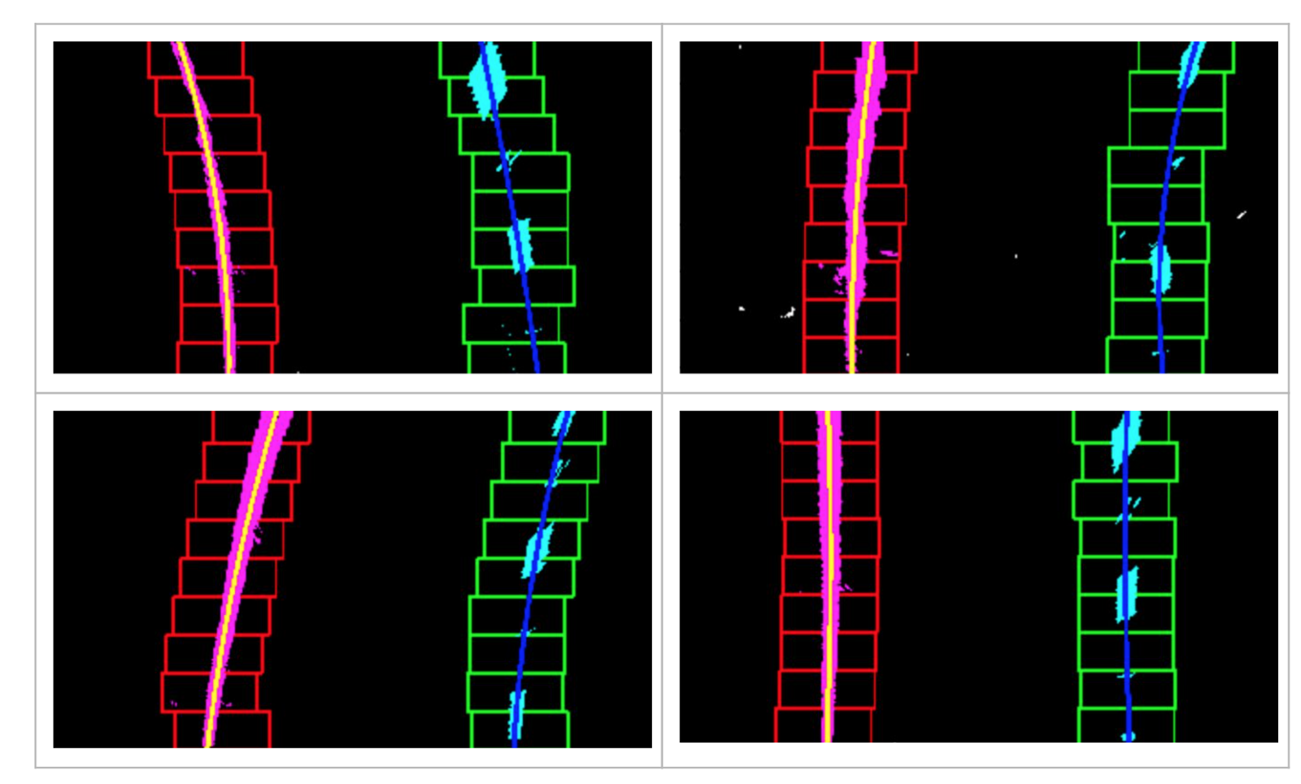
Paper 6: Sliding window approach based Text Binarization from Complex Textual images
This paper processed and classified individual pixels as text or background in textual images. The sliding window method is used to binarize text from textual images with textured background after the images are preprocessed. The results show that the proposed method is an effective method and outperforms the other methods in the complex/textured background situation.
We utilized the sliding window method in our project to collect all of the indices of lane line pixels in our images. By collecting all of these indices, we were able to relate each lane line pixel to the other lane line pixels to form the complete lane line.

Slide 11

Methodology
Compute the camera calibration matrix and distortion coefficients given a set of chessboard images and apply a distortion correction to raw images
Use color transforms and gradients to create a thresholded binary image
Apply a perspective transform to rectify binary image by changing to top-down view
Detect lane pixels and fit them to find the lane boundary and determine the curvature of the lane and the vehicle position with respect to center
Warp the detected lane boundaries back onto the original image and output visual display of the lane boundaries and numerical estimation of lane curvature and vehicle position

Slide 12
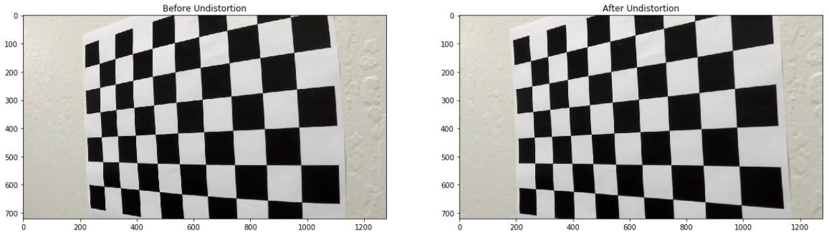
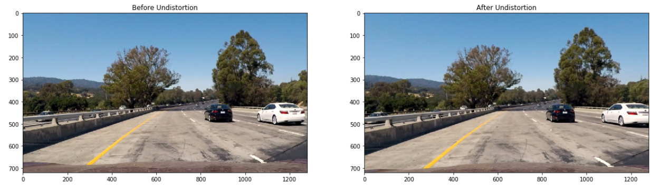
Compute the camera calibration matrix and distortion coefficients given a set of chessboard images
The round glass of the lens of the camera used to take our images causes distortion. Finding the corners of the chessboard images taken with the same lens allowed us to undistort the images; Since we know there should be a straight line between each corner and the adjacent corners.
We accomplished this using the Computer Vision functions: findChessboardCorners(), calibrateCamera(), and undistort().
Notes:
undistort_image(img, objpoints, imgpoints)

Slide 13
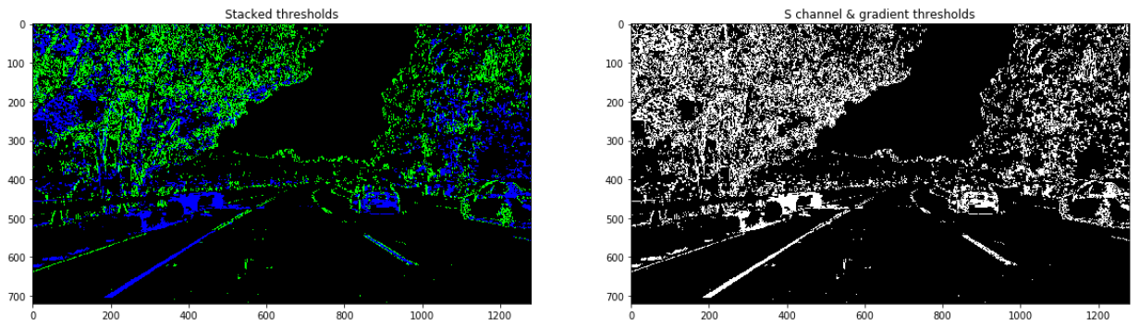
2. Use color transforms and gradients to create a thresholded binary image
We used a combination of color and gradient thresholds to generate a binary image. Separating the image into different color channels helps because we want to look at the color channel that defines the lane lines the best. In the program, we used color channel 's'.

Slide 14
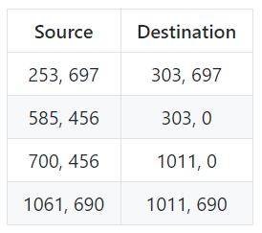
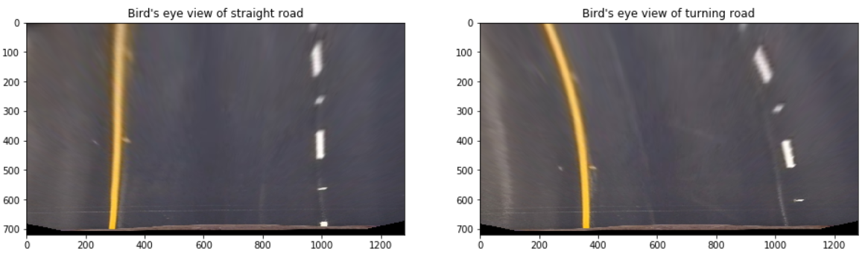
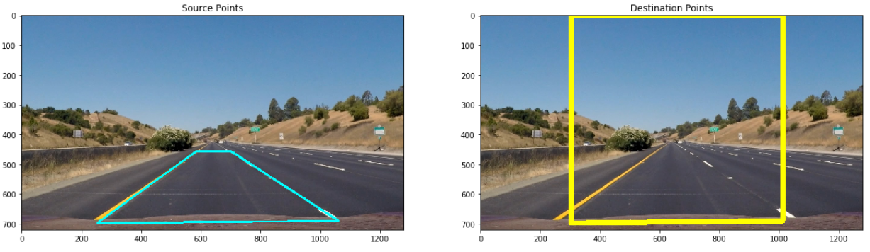
3. Apply a perspective transform to rectify binary image by changing to top-down view
We used a perspective transform to change the forward-facing images into a top-down perspective. This was done so that we could have better accuracy when identifying lane lines. We verified that the perspective transform was working as expected by drawing the src and dst points onto a test image and its warped counterpart to verify that the lines appear parallel in the warped image.

Slide 15
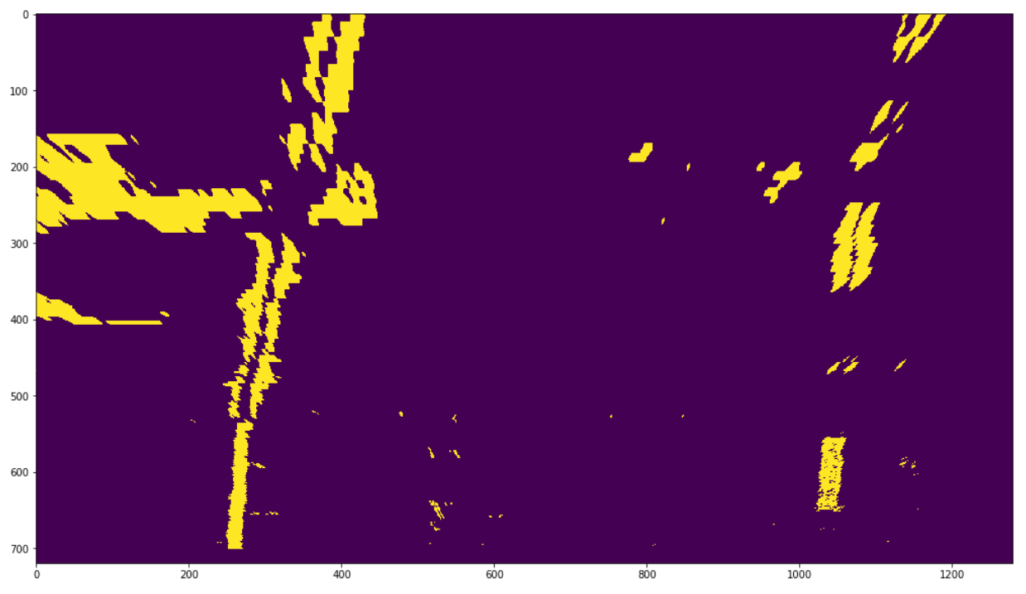
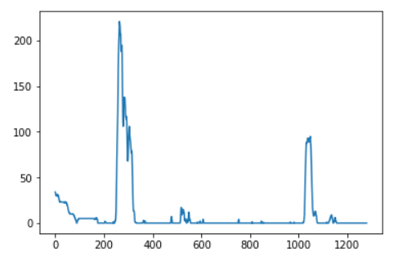
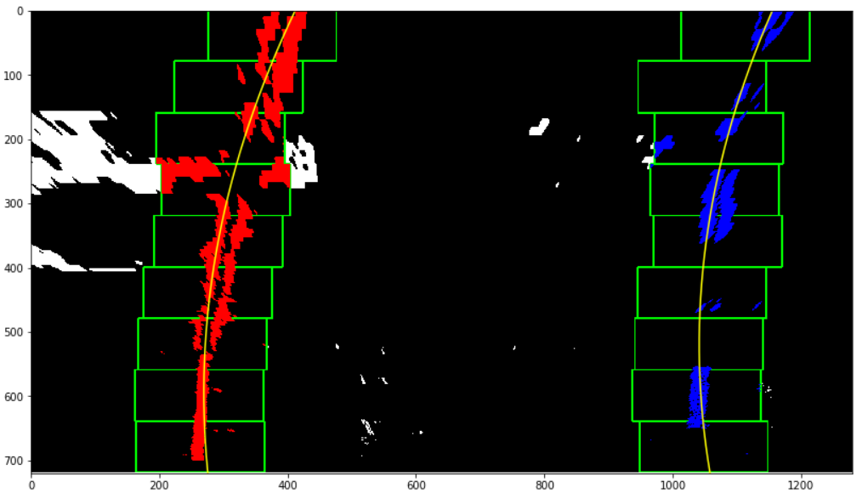
4. Detect lane pixels and fit them to find the lane boundary
We used a histogram to identify the lanes in the picture. The histogram graphed the places in the image where there was the brightest and most complete lines.
After identifying the lane lines (the peaks in the histogram), we then set the number of sliding windows that will localize exactly where in the image the lane lines reside.
We then slide the windows over the image collecting the indices for each lane line in an array. Then we fit these indices and move on to working with the curvature of the lane lines.

Slide 16
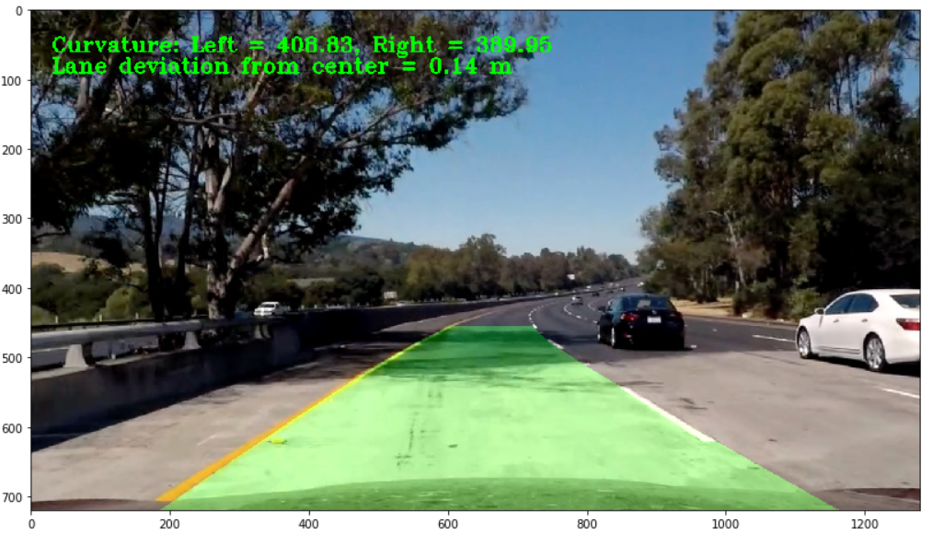
5. Warp the detected lane boundaries back onto the original image and output visual display of the lane boundaries and numerical estimation of lane curvature and vehicle position
This image represents the preliminary result of our implementation plotted back down onto the road such that the lane area is identified clearly. You can see the calculations in the upper left-hand corner.
Notes:
https://www.youtube.com/watch?v=RWCxH83OFEI

Slide 17
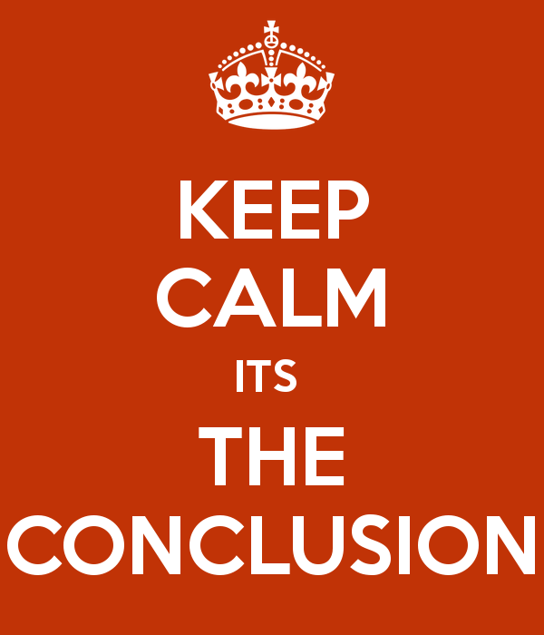
Evaluation/Interpretation/Conclusion
We learned a lot in completing this project. We got to experiment with computer vision, become more familiar with linear algebra, and become better at programming in python.
Our implementation is not perfect by any means. It does have high accuracy, but it has problems when the color of the road changes quickly. This may happen when moving from an asphalt road to concrete. If we had more time we would work on our thresholding more to eliminate this problem.
While we would not recommend this for use by any person or vehicle just yet, it is a step in the right direction for the initiative to improve safety on our roadways.

Slide 18
References
First, we read Lane Detection Techniques: A Review by Gurveen Kaur to get some ideas for our approach. We concluded that we could do better if we used more precise tools. We did not like how he used the Canny filter as opposed to Sobel Gx, and the information loss when he grayscaled his images.
We first noticed that the images in our dataset were distorted by the camera lens. The Camera Calibration with Distortion Models and Accuracy of Evaluation research paper by Juyang Weng helped us to learn how we could undistort the images using linear algebra. After searching some more, we discovered that we could use computer vision as well to fix the issue.
The second issue was deciding how we were going to detect the edges of our lane lines to segment them from the image. We read both the Structure-preserving color transformations using Laplacian commutativity by D. Eynard and the Study Sobel Edge Detection Effect on the Image Edges Using MATLAB by Elham J. Mohammad research papers to try to solve this problem. We decided to use the Sobel_x filter that is used to detect bright vertical edges.
Our third issue was that the image perspective was forward-facing. To resolve this we read the paper Transformation Technique by M. Venkatesh. This paper taught us how to change a forward-facing perspective into a top-down perspective by stretching out the image where it was too far away for our program to process. We could zoom in, but only in certain areas.
Our last issue was trying to calculate the complete lane line in the image with precision. To do this we read the paper The Periodic Moving Average Filter for Removing Motion Artifacts from PPG Signals by Han-Wook Lee. We learned to use a moving window filter to parse through the image and identify precisely where the lane line was most likely to be even if there were gaps between them.

Slide 19
Thank you for your attention! Any questions?

